Slide 1
Movie review
PROJECT GUDE
PRESENTED BY
Mrs. AKHILJITH B
Assistant Professor, Department of Computer Applications
SONA ROY
REGNO:210021093990 .
MOVIES REVIEW SYSTEM

Slide 2
CONTENTS
INTRODUCTION
DATA SET
PROPOSED SYSTEM
CLASS DIAGRAM
EXPERIMENT
FEATURE EXTRACTION
ML MODAL
RESULTS
CONCLUSION AND FUTURE WORK
REFERENCES
SCREENSHOTS
SENTIMENTAL ANALYSIS
MOVIES REVIEW SYSTEM

Slide 3
INTRODUCTION
An important method for evaluating a film’s performance is through movie reviews.
We can learn about the movie’s strengths and weaknesses from a textual review sentiment analysis, a pivotal component within natural language processing, is adept at discerning subjective tones from textual data.
The movie review sentiment analysis system is designed to automatically analyse and classify movie reviews as either positive or negative.
MOVIES REVIEW SYSTEM

Slide 4
SENTIMENTAL ANALYSIS
Sentiment analysis, also known as opinion mining
Sentiment analysis provides valuable insights into public opinion
Approaches
Challenges
MOVIES REVIEW SYSTEM

Slide 5
PROPOSED SYSTEM
The movie review sentiment analysis system is designed to automatically analyse and classify movie reviews as either positive or negative.
Leveraging natural language processing and machine learning algorithms.
NAIVE BAYES Type Evaluation.
Summarize sentiment scores.
The Deployment using FLASK (Web Framework).
MOVIES REVIEW SYSTEM

Slide 6
DATA SET
IT IS A IMBD DATA SET OF REVIEWS.
IT HAS 2 COLUMN AND 50001 ROW’S .
FIRST COLUMN INDICATE REVIEWS.
SECONDO COLUMN INDICATE SENTIMENTS EITHER POSITIVE OR NEGATIVE.
MOVIES REVIEW SYSTEM

Slide 7
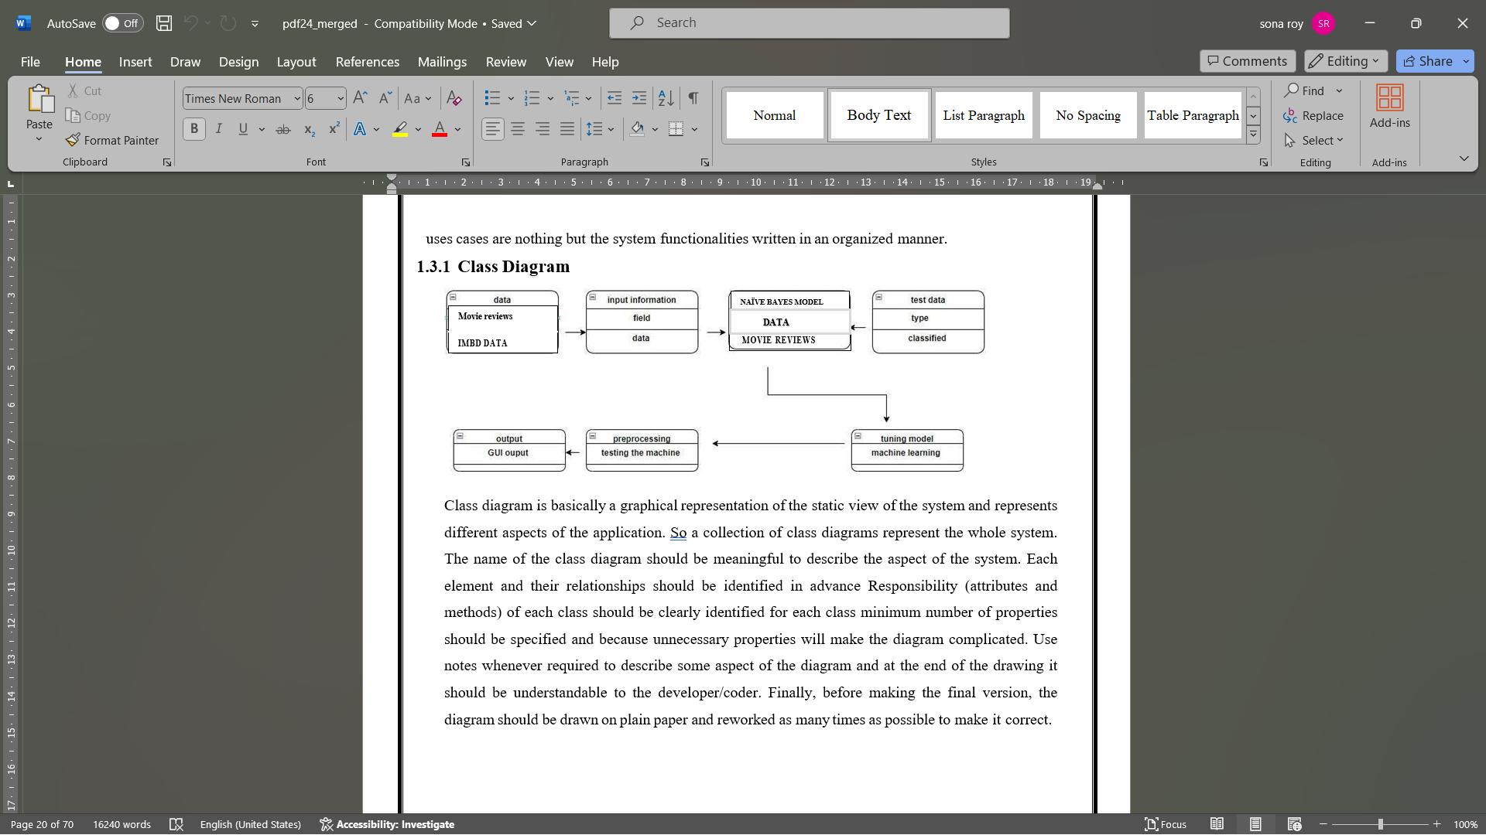
CLASS DIAGRAM
MOVIES REVIEW SYSTEM

Slide 8
EXPERIMENT
GATHERING DATA
TEXT PRE-PROCESSING
FEATURE EXTRACTION
SPLITTING THE DATA
ML MODEL NAÏVE BAYES
TRANINING THE DATA
COMPARISON OF ACCURACY
DEPLOYMENT USING FLASK
MOVIES REVIEW SYSTEM

Slide 9
FEATURE EXTRACTION
TF-IDF
Term Frequency – Inverse Document Frequency.
It is one of the most important techniques used for information retrieval to represent how important a specific word or phrase is to a given document.
TF-IDF = TF * IDF
TF-IDF = TF * log(N/DF)
MOVIES REVIEW SYSTEM

Slide 10
ML MODAL
Naive Bayes algorithm:
The Naive Bayes algorithm is an intuitive method that uses the probabilities of each attribute belonging to each class to make a prediction. It is the supervised learning approach you would come up with if you wanted to model a predictive modeling problem probabilistically.
Gaussian Naive Bayes
Multinomial Naive Bayes
Bernoulli Naive Bayes
MOVIES REVIEW SYSTEM

Slide 11
RESULTS
Name | Accuracy values
GaussianNB | 0.8016
MultinomialNB | 0.8437
BernoulliNB | 0.8429
Name | Precision scores
GaussianNB | 0.8024
MultinomialN | 0.8369
BernoulliNB | 0.8427
Name | Recall values
GaussianNB | 0.8352
MultinomialNB | 0.8560
BernoulliNB | 0.8456
Name | F1 scores
GaussianNB | 0.8029
MultinomialNB | 0.8463
BernoulliNB | 0.8441
MOVIES REVIEW SYSTEM

Slide 12
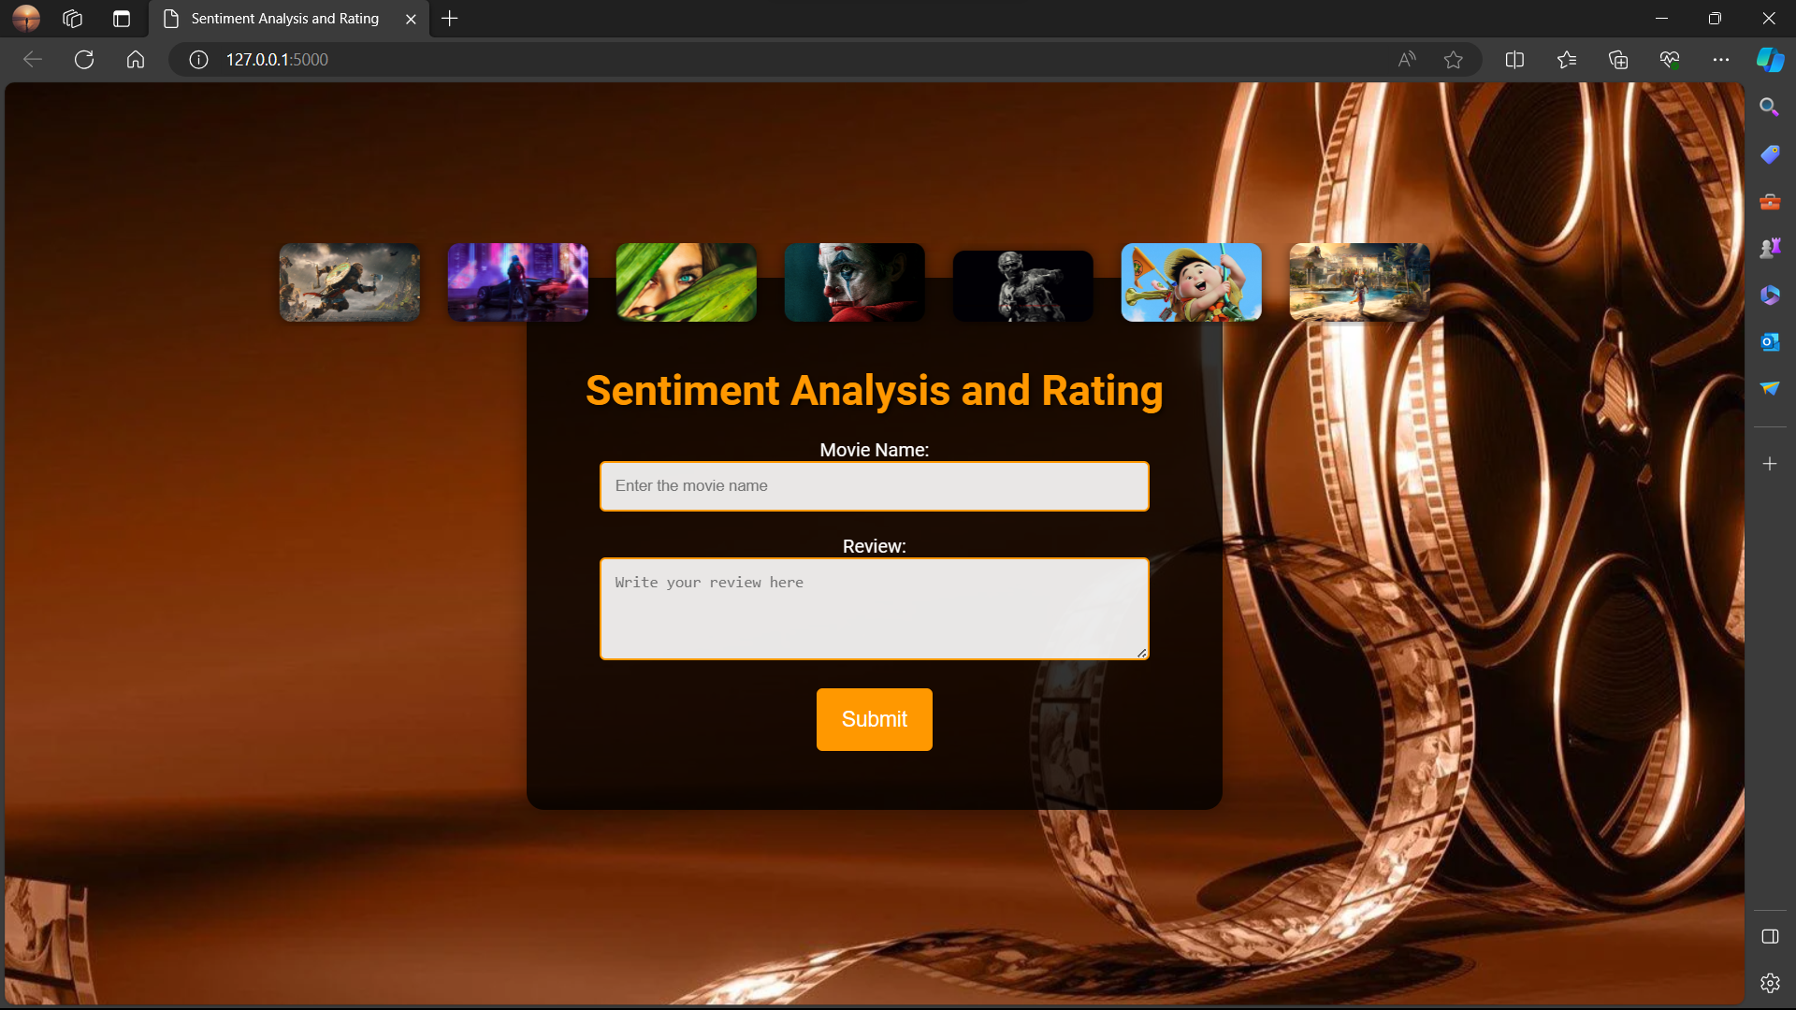
SCREENSHOTS
MOVIES REVIEW SYSTEM

Slide 13
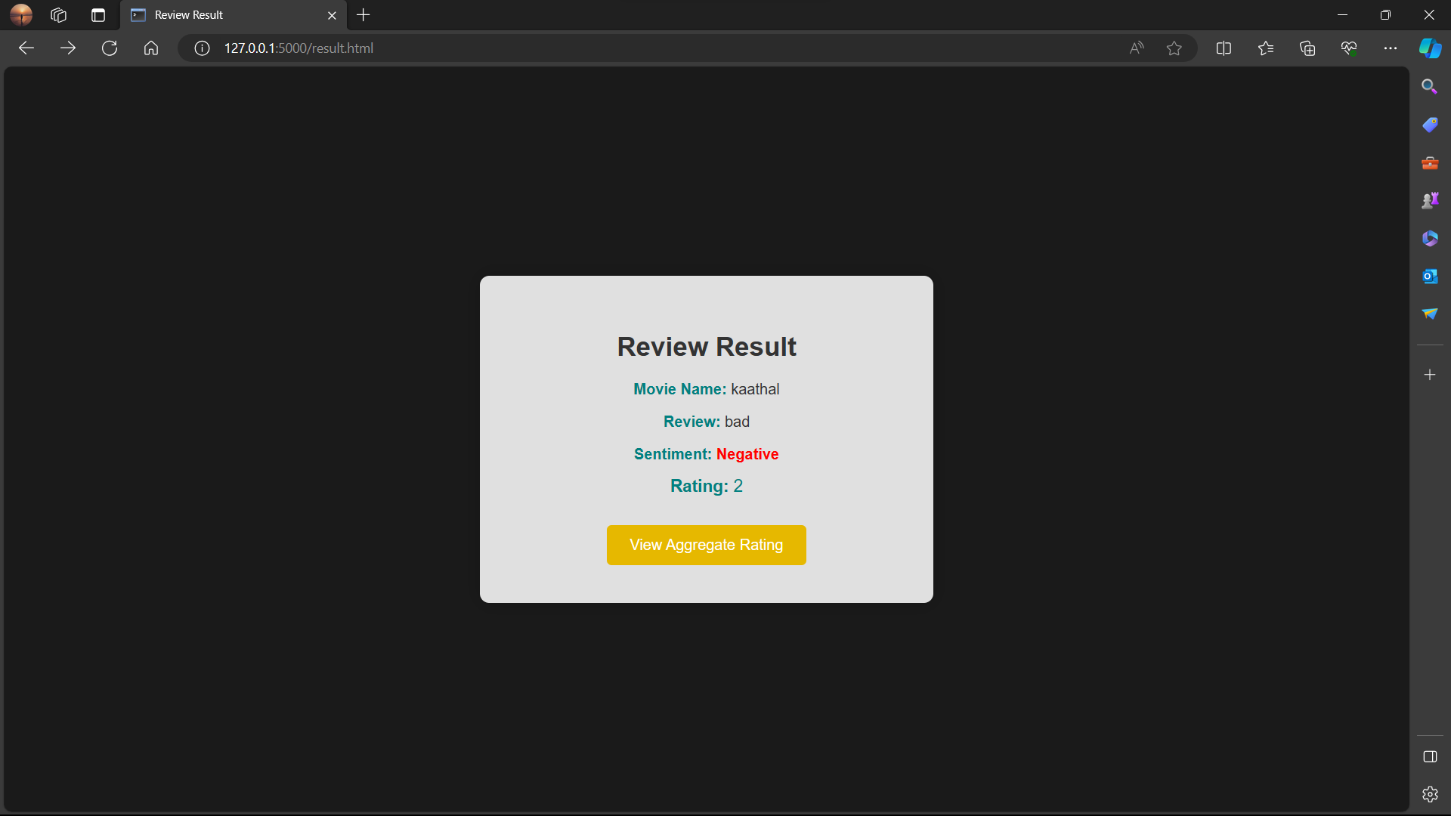
SCREENSHOTS
MOVIES REVIEW SYSTEM

Slide 14
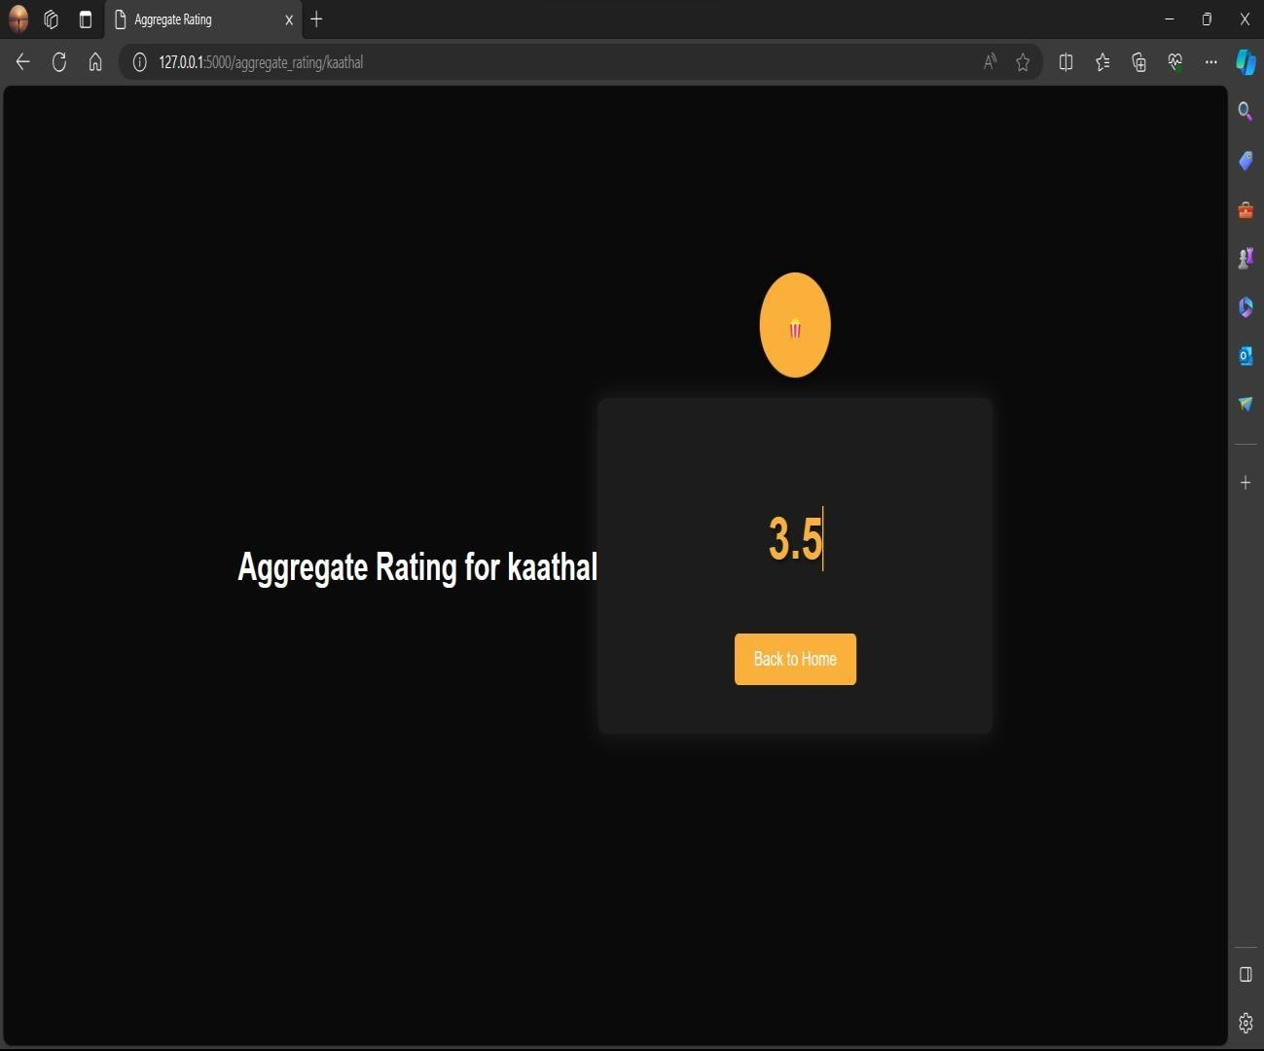
SCREENSHOTS
MOVIES REVIEW SYSTEM

Slide 15
CONCLUSION AND FUTURE WORK
Sentiment analysis of movie reviews serves as a valuable tool for comprehending the public's perception of a film.
It offers movie studios and marketers insights into the film's success and enables them to adapt strategies accordingly
We can further extend this to a multi-class classification problem .
For more precise classification, we can use live data that is immediately acquired from online domains using web scraping techniques.
For better outcomes, the proposed methodology can be done and assessed using a hybrid model that combines traditional methods using lexicons with deep learning models like neural networks.
Merging words with similar meanings before training the classifiers is one of the significant enhancements that can be implemented as we progress in this project.
MOVIES REVIEW SYSTEM

Slide 16
REFERENCES
.
[1] An Han, Liu Hao, and Ren Jifan. An empirical study on inline impact factors of review usefulness based on movie reviews. In 2016 13th International Confer- ence on Service Systems and Service Management (ICSSSM), pages 1–5, June 2016. ISSN: 2161-1904.
[2] Mahesh Joshi, Dipanjan Das, Kevin Gimpel, and Noah A. Smith. Movie Re- views and Revenues: An Experiment in Text Regression. In Human Language Technologies: The 2010 Annual Conference of the North American Chapter of the Association for Computational Linguistics, pages 293–296, Los Angeles, Cal- ifornia, June 2010. Association for Computational Linguistics.
[3] prediction based on Twitter data using lexicon-based sentiment analysis. In 2021 11th International Conference on Cloud Computing, Data Science & Engineering (Confluence), pages 136–141, January 2021
MOVIES REVIEW SYSTEM

Slide 17
THANK YOU
MOVIES REVIEW SYSTEM

